Slide 1


BIG DATA PROJECT: elon musk twitter sentiment analysis
DAVIDSON DACLEU

Slide 2

Agenda
INTRODUCTION
OBJECTIVE
DATA
MODELLING
FINDINGS
CONCLUSION
Notes:
For this project, we will have the following plan.
Will start with
Then
Going deeper the data
Present over modelation
And end with the conclusion

Slide 3
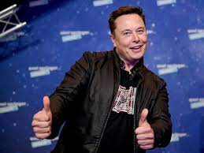
Introduction
Twitter influencer 91M
Richest man in the world : 255.1 B
On the beginning of April tweet on the fact that He want to buy twitter
Elon musk buys twitter for 44B$ on 29th April

Slide 4
Objective : Sentiment analysis
After made a tweet on his intentions to buy twitter “to make the bird free”, Twitter became crazy. So, we decided to scrape twitter by using twitter API in the aim to:
Have a clear idea of the sentiment concerning ‘Elon buying twitter’
See what was the opinion of the most reacting person(based on the number of tweets)
See what was the sentiment of the influencers account (based on the number of followers)
See if the fact that he bought twitter on the 29th, makes a lot of differences in the general sentiment.
See any relevant information that we can add at the top

Slide 5
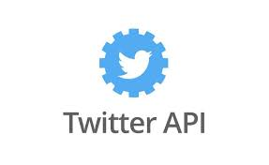



Data:
Programmatic access to Twitter
Web services that provides resizable capacity
Databricks is a cloud-based collaborative data plateform
Datasets
Storage for the internet

Slide 6
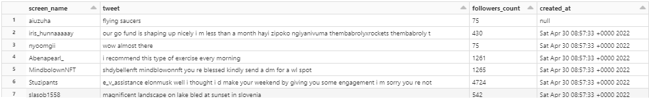
Data: cleaning
From tweets, we should remove:
remove URLs
remove Symbol of retweet (RT @name) : We should keep the the text of the retweet because people comment a lot Elon tweets or any twitter related
remove Special Caracter, spaces
make lowering and trimming
We also remove all tweets with no values after cleaning
We need to remove some useless columns such as name, id(id is unique, screen name is unique, but it can be more meaningful),user location, user tweet(we get a lot of missing)

Slide 7
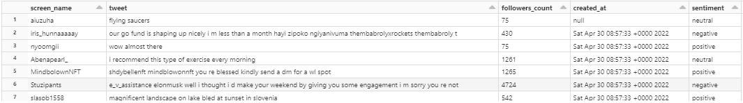
DATA: Get sentiment
Textblob

Slide 8
Modelling:
Tokenizer
Remove Stop words
Count Vectorizer
TF-IDF Vectorization
Labeling
Linear Regression
Scoring: 97.97 %

Slide 9
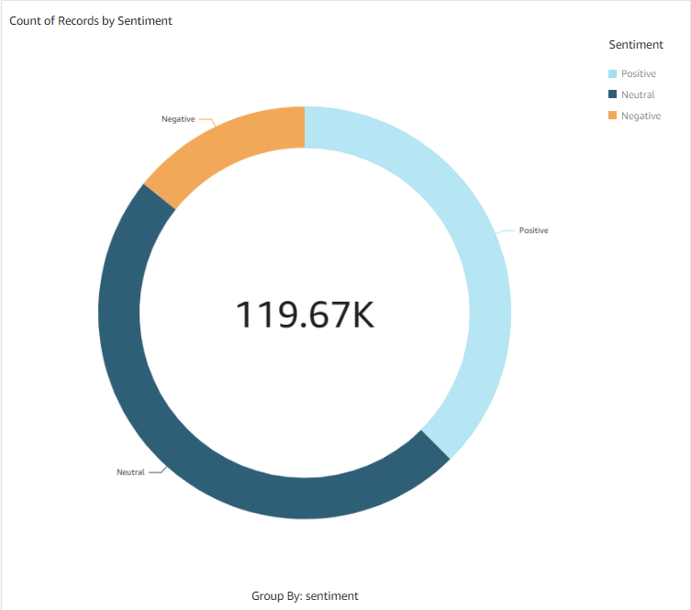
FINDINGS: General sentiment

Slide 10
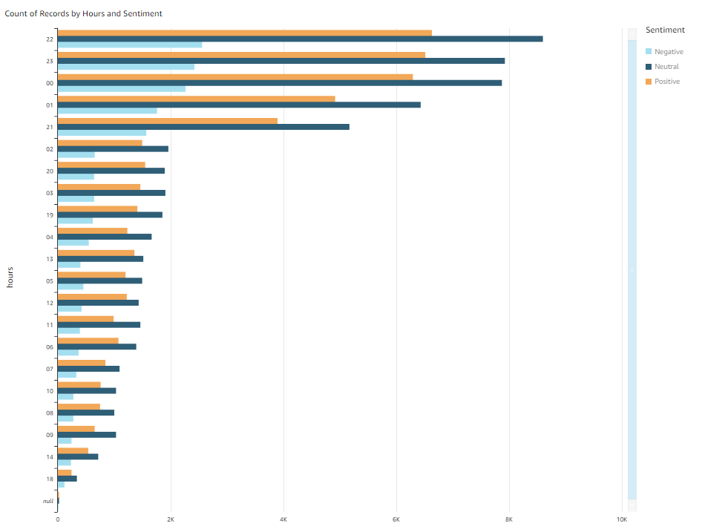
FINDINGS: Sentiment and hours

Slide 11
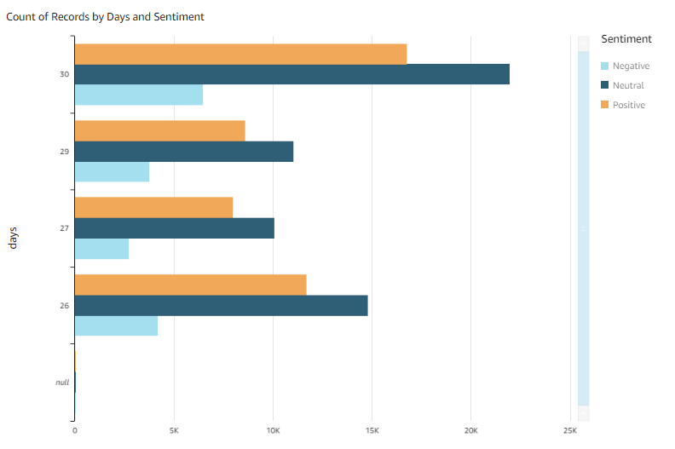
FINDINGS: sentiment and day

Slide 12
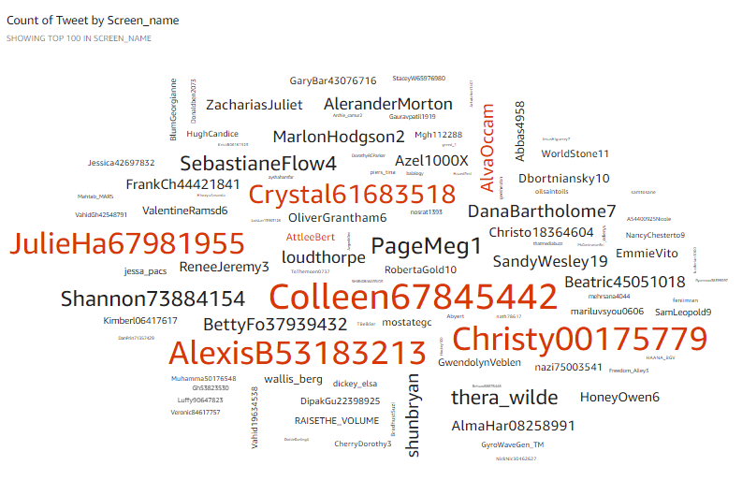
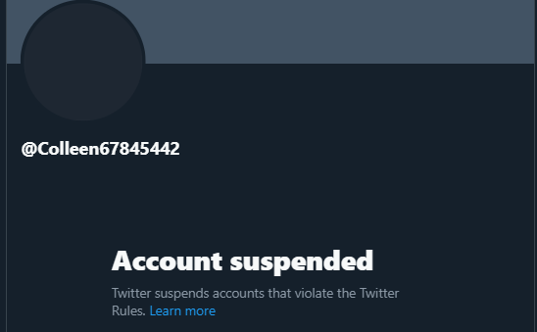
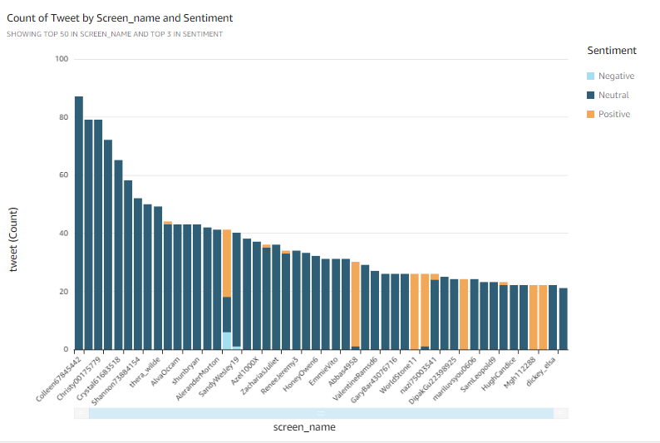
FINDINGS: most reactive account
Notes:
Suspended ?
Bot ? Same pattern …

Slide 13
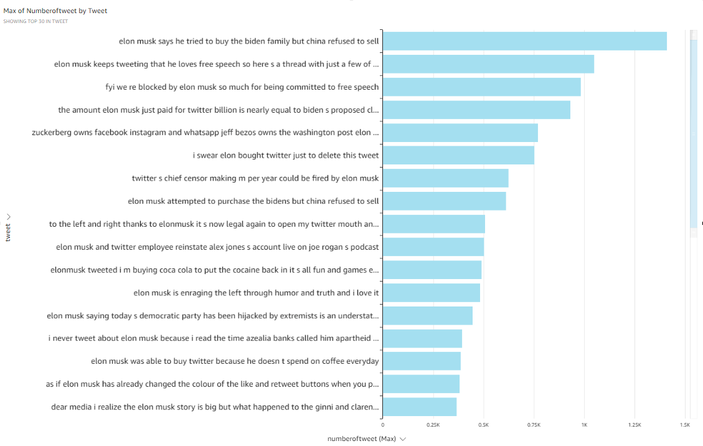
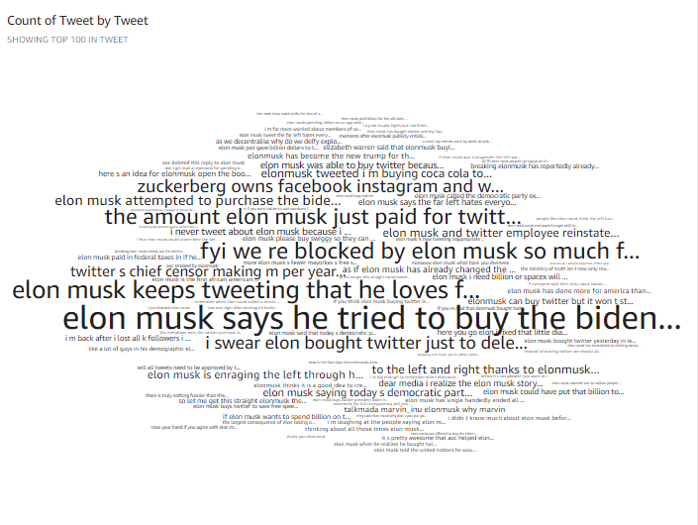
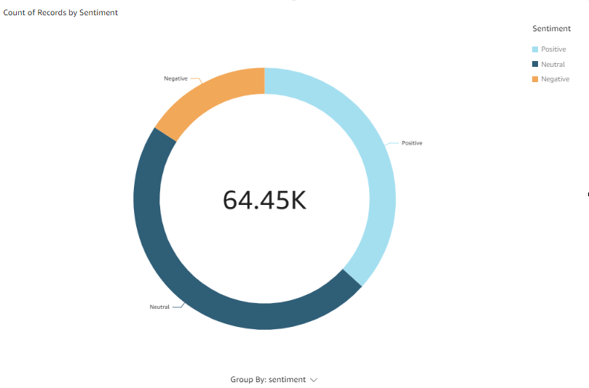
FINDINGS: Tweets that appeared the most

Slide 14
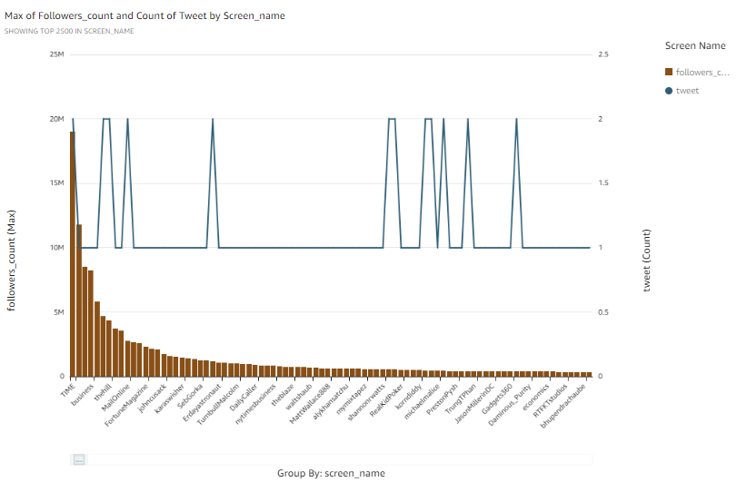
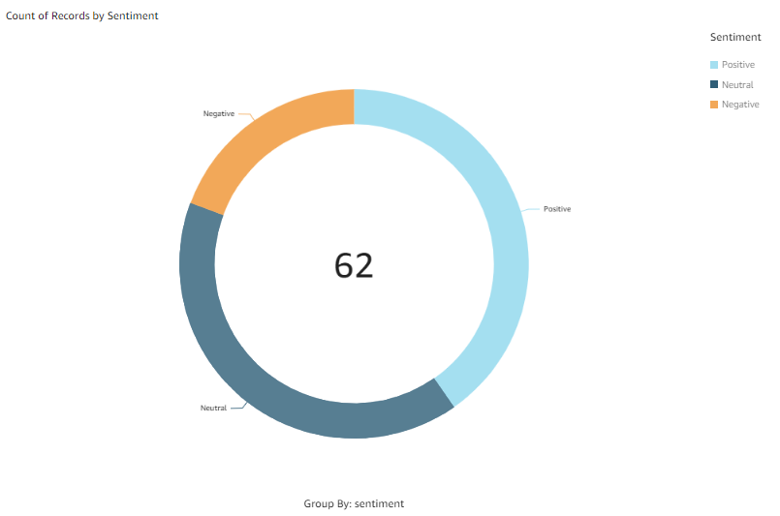
FINDINGS: Influencers (more than 500k followers)

Slide 15

conclusion
Neutral sentiment : A lot of tweets which doesn’t express emotions
Duplicate tweets: Mostly form bots and viral sentences

